Slide 1
Python programming
unit 3a – recursion, stdin

Slide 2
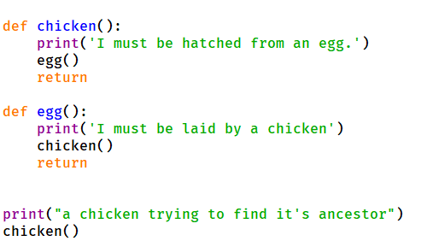
What is recursion
Function call loop
When a function call itself
When a function call other function, but other function finally calls back to this function again
It can be infinite and never return if the loop cannot break

Slide 3
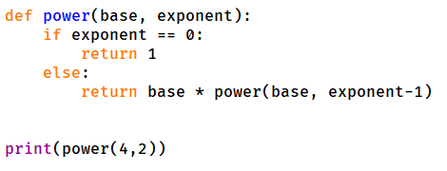
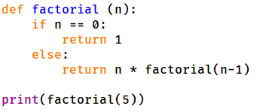
What is recursion
In the Function call loop
Each time the conidiation should have slight difference
When the condition reaches certain value, then it does not need continue to call, can find the result and return

Slide 4
What is stdin and how to use it
Stdin is one input device, for human to send information into computer
Use input() function in python. (a build-in function, no need import anything)
Use sys.stdin device. (need import sys)
User fileinput module. (need import fileinput)
fileinput.input(), fileinput.close(), and for loop to read line by line.

Slide 5
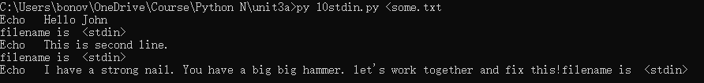
Command line redirection of input/output
Command line ‘>’ redirect stdout to a file
Command line ‘<‘ redirect stdin from a file

Slide 6
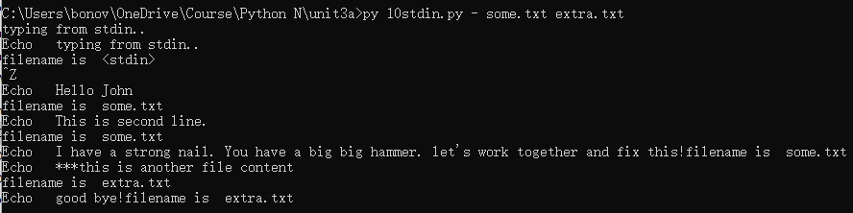
fileinput
The fileinput: can read from a list of files, file name specified by args[1:]
If have ‘-’, this will be stdin
If have no args[1] and after, default will read from stdin.
Ctrl+z then enter, as EOF from stdin. ( ctrl+D will give you EOF through stdin on unix. ctrl+Z on windows )

